Slide 1
MODULE -2
Ms. Amrutha S
A.P, CED

Slide 2
STEPS IN EIA PROCESS
Project Screening: screening often results in a categorization of the project and from this a decision is made on whether or not a full EIA is to be carried out.
Scoping: is the process of determining which are the most critical issues to study and will involve community participation to some degree.
Consideration of alternatives: This seeks to ensure that the proponent has considered other feasible approaches, including alternative project locations, scales, processes, layouts, operating condition and the no-action option.
Description of the project/development action: This step seeks to clarify the purpose and rationale of the project and understand its various characteristics, including the stages of development, location and processes.

Slide 3
Description of the environmental baseline: This includes the establishment of both the present and future state of the environment, in the absence of the project, taking into account the changes resulting from natural events and from other human activities.
Identification of key impacts: This brings together the previous steps with a view to ensuring that all potentially significant environmental impacts (adverse and beneficial) are identified and taken into account in the process.
The prediction of impacts: This step aims to identify the likely magnitude of the change (i.e., impact) in the environment when the project is implemented in comparison with the situation when the project is not carried out.
Evaluation and assessment of significance: This seeks to assess the relative significance of the predicted impacts to allow a focus on key adverse impacts. Formal definition of significance is the product of consequence and likelihood as
Significance =consequence X Likelihood

Slide 4
Mitigation: This involves the introduction of measures to avoid, reduce, remedy or compensate for any significant adverse impacts.
Public consultation and participation: This aims to assure the quality, comprehensiveness and effectiveness of the EIA, as well as to ensure that the public’s views are adequately taken into consideration in the decision-making process.
EIS presentation: This is a vital step in the process. If done badly, much good work in the EIA may be negated.

Slide 5
Review: This involves a systematic appraisal of the quality of the EIS, as a contribution to the decision-making process.
Decision-making: At this stage, decisions are made by the relevant authority of the EIS (including consultation responses) together with other material considerations as to whether to accept, defer or reject the project.
Post-decision monitoring: This involves the recording of outcomes associated with development impacts, after the decision to proceed with the project. It can contribute to effective project management.
Auditing: This follows monitoring and involves comparing actual outcomes with predicted outcomes, and can be used to assess the quality of predictions and the effectiveness of mitigation. It provides a vital step in the EIA learning process

Slide 6
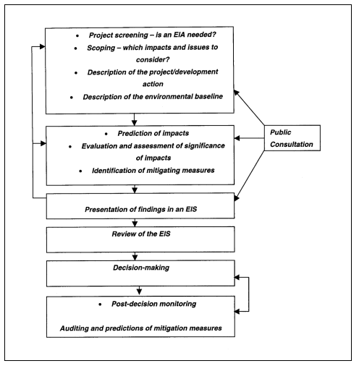

Slide 7
ELEMENTS OF EIA
Stage 1: Screening (Only for Category ‘B’ projects and activities)
Stage 2: Scoping
Stage 3: Public Consultation
Stage 4: Appraisal

Slide 8
Stage 1: Screening
Only for Category B projects and activities to determine if they need EIA
Category A projects compulsorily need EIA
Scrutiny of an application by SEAC for determining whether or not the project or activity requires further environmental studies
Classify projects as B1 (require EIA) and B2 (don’t require EIA)
For categorization of projects into B1 or B2, the MoEF shall issue appropriate guidelines from time to time

Slide 9
Stage 2: Scoping
In the case of Category A Hydroelectric projects ToR shall be conveyed along with the clearance for pre-construction activities.
If ToR not finalized and conveyed to the applicant within sixty days of the receipt of Form 1, ToR suggested by the applicant shall be deemed as the final ToR approved for the EIA studies.
Approved ToR shall be displayed on the website of the MoEF or the concerned SEIAA.
Applications for EC may be rejected at this stage itself
the decision together with reasons for the same shall be communicated to the applicant
Prepare EIA draft report

Slide 10
Stage 3: Public consultation
Process by which the concerns of local affected persons and others who have plausible stake in the environmental impacts of the project or activity are ascertained
All Category ‘A’ and Category B1 projects or activities shall undertake Public Consultation

Slide 11
Public Consultation shall ordinarily have two components
public hearing at the site or in its close proximity- district wise, to be carried out in the manner prescribed in Appendix IV, for ascertaining concerns of local affected persons
obtain responses in writing from other concerned persons having a plausible stake in the environmental aspects of the project
Public hearing shall be conducted by the State Pollution Control Board (SPCB)

Slide 12
Component 1: Public hearing
forward proceedings to the regulatory authority concerned within 45 days
If not, appoint another independent organization to do the same within another 45 days
If the public agency nominated reports that it is not possible to conduct the public hearing in a manner which will enable the views of the concerned local persons to be freely expressed
It shall report the facts in detail to the concerned regulatory authority

Slide 13
Component 2: Responses from other concerned persons
Invite responses from such concerned persons by placing on their website the Summary EIA report
Use other appropriate media for ensuring wide publicity about the project
Within seven days of the receipt of a written request for arranging the public hearing
Confidential information including non-disclosable or legally privileged information involving Intellectual Property Right shall not be placed on the website
Make available on written request from any concerned person the Draft EIA report for inspection at a notified place during normal office hours till the date of the public hearing
All the responses received as part of this public consultation process shall be forwarded to the applicant through the quickest available means

Slide 14
After public consultation…
Applicant shall address all environmental concerns expressed during this process
Make appropriate changes in the draft EIA
Final EIA report shall be submitted by the applicant to the concerned regulatory authority for appraisal

Slide 15
Stage 4: Appraisal
Detailed scrutiny by the EAC or SEAC of
documents like the Final EIA report
outcome of the public consultations including public hearing proceedings
submitted by the applicant to the regulatory authority concerned for grant of environmental clearance
Appraisal of all projects or activities which are not required to undergo public consultation, or submit an Environment Impact Assessment report (Category B2) shall be carried out on the basis
prescribed application Form 1
Form 1A
any other relevant information

Slide 16
EAC or SEAC shall
shall recommend to the regulatory authority concerned
either for grant of prior environmental clearance on stipulated terms and conditions
or rejection of the application for prior environmental clearance, together with reasons for the same.
Prescribed procedure for appraisal is given in Appendix V

Slide 17
Classification
EIA is also categorised based on systematic analysis of
environmental parameters
geographical region
carrying capacity limitations and
sectoral planning.
They are
Strategic EIA
Regional EIA
Sectoral EIA
Project level EIA and
life cycle assessment.

Slide 18
Strategic EIA
Strategic EIA refers to systematic analysis of the environmental effects of development policies, plans, programs and other proposed strategic actions.
This process extends the aims and principles of EIA upstream in the decision- making process, beyond the project level and when major alternatives are still open.
Strategic EIA represents a proactive approach to integrate environmental considerations into the higher level of decision-making.
The global scale of the ozone and climate change problems was a confirmation that environmental deterioration was accelerating, in spite of the international initiatives set in motion, initially by the Stockholm conference of 1972, and then by subsequent international forums.

Slide 19
By the late 1980s and early 1990s, experience of EIA over projects and regional plans led to the recognition that EIA of policies should be conducted on a strategic level.
A strategic environmental assessment (SEA) makes an inquiry into the likely environmental changes (both positive and negative) resulting from the development produced by existing, new, or revised developmental policies, plans, and programmes.
Examples of SEA are:
policy of industrializing coastal belts;
policy of depending on hydropower rather than on thermal power on a national basis;

Slide 20
The main steps of an SIA are similar to those for EIA but are applied to the PPP(policy, planning and program) level. There is no one method for conducting an SIA and as such, each SIA process will be different. In general, however, the key steps include:
Screening - is an SIA is required (e.g., legislation, policies, requirements etc.), what type of SIA is needed, when is it required.
Scoping - what is the aim of the PPP, are there any significant strategic issues, who are the stakeholders, what is the current state of the environment.
Impact assessment - identify all inputs into the SIA, constraints, project impacts, opportunities and trends, develop objectives, criteria and indicators.

Slide 21
Developing parameters, principles or guidelines - these are used to guide the SIA process and can include recommendations on addressing environmental or socio-economic impacts.
Comparing and evaluating alternative PPPs - preferred alternative/s selected, trade-offs made, public participation sought.
Decision-making - responsibilities and accountabilities assigned, SIA process is checked, final decision documented.
Monitoring and review - develop an implementation plan, begin monitoring and review of the project.
Implement the selected proposal.

Slide 22
Regional EIA
EIA in the context of regional planning integrates environmental concerns into development planning for a geographic region, normally at the sub- country level.
The scope and level of EIA need to be expanded further when regional plans and developments are to be considered. An EIA can thus be performed at various levels depending on the scale of a development activity.
Regional EIA is a comprehensive EIA conducted for a particular region to establish the baseline Environmental status and also to assess the assimilative capacity of the region.
Such an approach is referred to as the economic-cum- environmental (EcE) development planning.
This approach facilitates adequate integration of economic development with management of renewable natural resources within the carrying capacity limitation to achieve sustainable development.

Slide 23
Regional EIA addresses the environmental impacts of regional development plans and thus, the context for project-level EIA of the subsequent projects, within the region.
Regional EIA's may be used where a number of similar but significant development activities with potentially cumulative impact are planned for a reasonably localized area. In such cases, regional EIA are generally more efficient than a series of project specific EIA's.
In a large industrial estate, for example, while the individual industrial emissions may be within tolerance limits, the cumulative effects of the emissions can lead to a serious deterioration of the regional air quality.

Slide 24
Sectoral EIA
Sectoral EIA will help to address specific environmental problems that may be encountered in planning and implementing sectoral development projects
Sector EIA's are used for the design of sector investment programs.
They are particularly suitable for reviewing (a) sector investment alternatives (b) the effect of sector policy changes (c) institutional capacities and requirements for environmental review implementation and monitoring at the sectoral level
Sectoral EIA should also have the objective of strengthening the environmental management capability of the several or other relevant agencies. Sectoral EIA's, may overlap with regional EIA's

Slide 25
Project Level EIA
Project level EIA refers to the developmental activity in isolation and the impacts that it exerts on the receiving environment.
In many countries in the world where EIA is in place, developmental projects such as construction of highways and expressways, ports and harbors', hydropower projects, manufacturing industries, mining projects, etc., undergo an environmental examination prior to being given clearance to establish and operate.
The EIA study then recommends appropriate mitigation measures or monitoring and management plans in the project itself.

Slide 26
Examples of such modifications include:
change in the alignment of a highway
· establishment of oil spill emergency operations for a port
· reducing the height of a dam;

Slide 27
Rapid EIA
Components of EIA Comprehensive EIA and Rapid EIA vary only in the time scale of the data supplied.
Rapid EIA is for speedier appraisal process.
Rapid EIA achieves this through the collection of ‘one season’ data, which ever is stressful for the project, only to reduce the time required.
But this is acceptable only if it does not compromise on the quality of decision making
The Rapid EIA is a widely used methodology, which would mainly use available data along with baseline Environmental data collected for one season (preferably winter), for evaluating all possible impacts on the components of Environment.

Slide 28
Winter season is considered as the critical meteorological situations for Air Pollution, when the mean air temperature is too low and average wind speed will also be less, this condition limits the dispersion of gaseous pollutants in atmospheric air thus increasing the Ground level Concentrations (GLC) of pollutants

Slide 29
Comprehensive EIA (CEIA)
Comprehensive EIA would be required if the assessment area, period and parameters are insufficient for a well-defined decision on the establishment of a project.
Meteorological Conditions like Mean Air Temperature, Wind Speed and Wind Direction (for different seasons) also play an important role in ascertaining the impact of pollutants especially when the project discharges huge quantities of Air Pollutants into the atmosphere.
A comprehensive EIA would be essential for large projects or for projects with high pollution levels.
Comprehensive Environmental Impact Assessment report has to be submitted after the evaluation of Rapid Environmental Impact Assessment report, if so asked by the Impact Assessment Agency.

Slide 30
The Initial Environmental Examination (IEE)
It is the process of reviewing the environmental integrity of projects to determine whether EIA level studies should be conducted.
This is used to determine which project require full scale EIA
This is done to minimize the effort, expense and delay in project planning.
In IEE, the environmental effects of proposed project are evaluated in limited budget based o available recorded information and professional judgement.
IEE is a means of providing the most efficient and feasible preparation of adequate environment management plans with or without the requirement of a full scale EIA.

Slide 31
The Terms of Reference is prescribed for Project seeking Environmental Clearance (EC) under the provision of the Environment Impact Assessment Notification, 2006
TOR for all the sectors requiring EC should be standardized as determining TOR for every case individually is time consuming and after arbitrary.
The standard TOR have been developed by the inputs from experts and have been recommended by the EACs of the respective sectors.
TOR or Terms of Reference is a document produced by the authority conducting the EIA study.
It is formed during Scoping, the second stage in the EIA process.

Slide 32
All the stakeholders are invited to submit their concerns regarding the project during a public hearing organized by the EIA committee, which is followed by discussions and deliberations.
The finalized list of this stage of EIA is submitted to the Ministry in the form of TOR.
A TOR is drawn up with the following questions in mind.
The purpose of the study/project.
The extent of the study.
The stakeholders’ requirements; each stakeholder looks at different aspects of the project differently. Complex information needs to be explained appropriately.

Slide 33
TOR highlights the points that need to be covered (the TOR itself does not elaborate on these points unless required) during the EIA study, which include:
A description of the project, it’s purposes and extent.
All the agencies responsible in the developmental project and the EIA study.
A description of the existing environmental conditions in the project site and surrounding areas.
The stakeholders that will be benefited and harmed by the fulfillment of the project.
The environmental aspects the project is likely to affect.
The impacts, both positive and negative, the project will have on the environmental and social aspects of the project area. This is undertaken through checklists, matrices or networks.
A list/description of the species endemic to the area, which are likely to be effected.

Slide 34
How in-depth does the EIA study need to be: whether baseline data is available or whether the study be sourced from secondary data.
Possible alternatives for the project in terms of design, site, technology, implementation, etc.
The legal requirements of the project and future legislation that need to be drafted.
If the project site comes under special categories, and the legislation regarding the same.
Recommended mitigation strategies.
The expertise required for the EIA study.
The expected time limit for the entire EIA study.
Natural Resource Valuation (NRV), if possible.
The budget of the study, also called cost-benefit analysis.

Slide 35
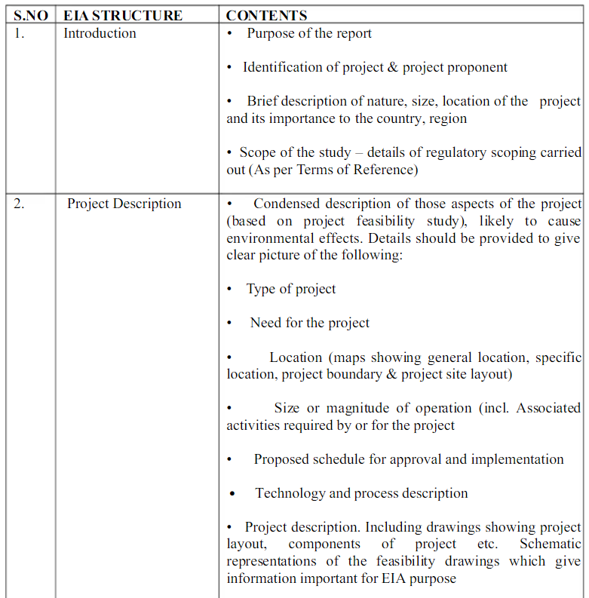
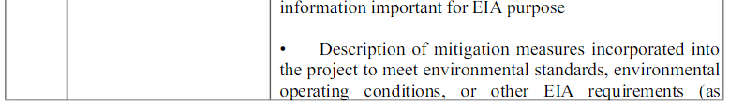
GENERIC STRUCTURE OF EIA DOCUMENT

Slide 36
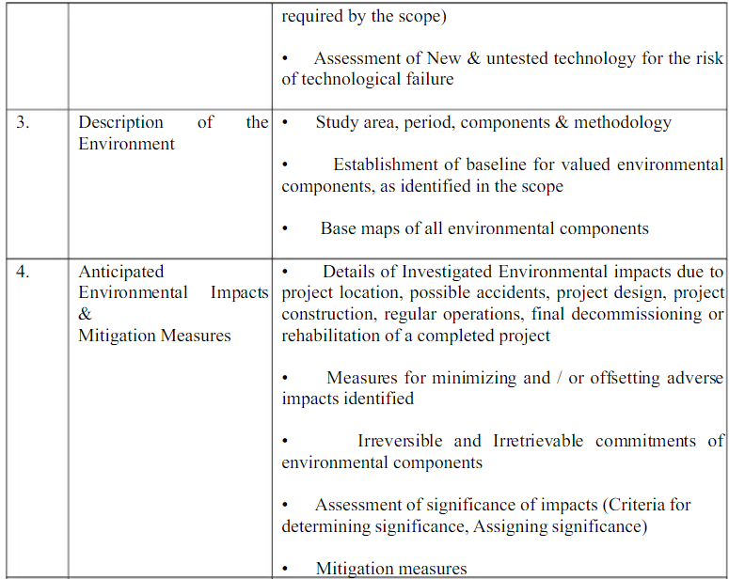

Slide 37
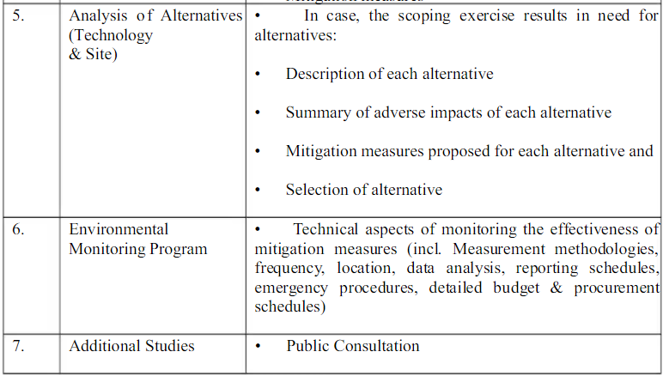

Slide 38
